Slide 1
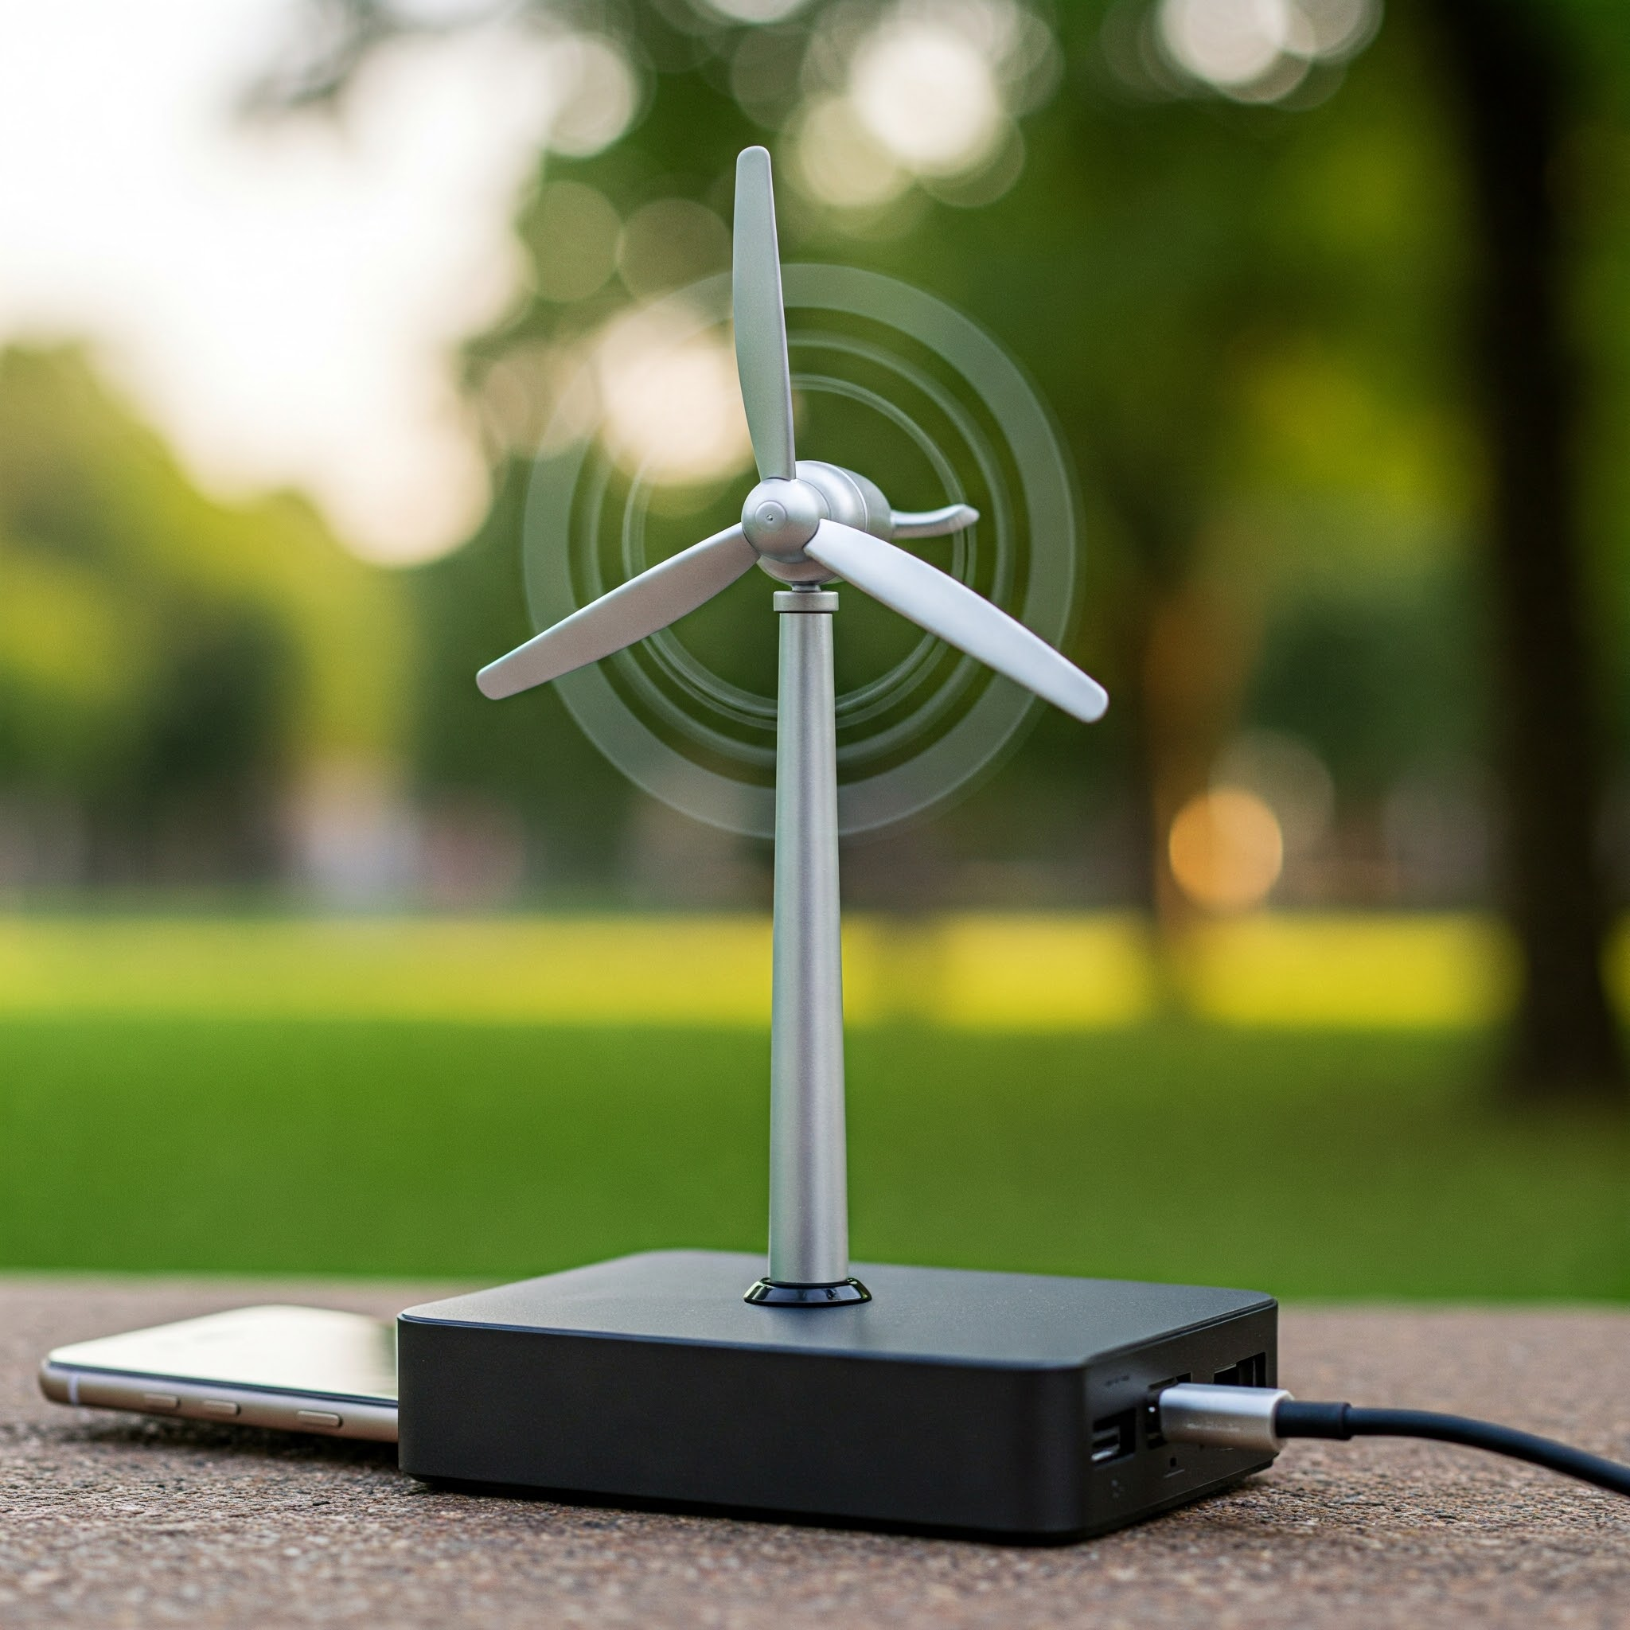
Smart Charging System

Slide 2
Introduction
This project aims to develop a mobile charging power bank that utilizes a turbine to generate electricity in moving vehicles like buses and trains. The generated electricity is stored in a battery and used to charge mobile phones, similar to home charging.

Slide 3
Problem Statement:
In today's fast-paced world, passengers traveling by buses and trains often face difficulties in charging their mobile devices, especially during long journeys. Existing charging facilities in public transport are either limited, unavailable, or dependent on the vehicle's electrical system, increasing energy consumption.
To address this issue, this project aims to develop a self-sustaining mobile charging power bank that utilizes a wind turbine and generator setup to generate electricity from the vehicle's motion.
The system will store the generated energy in a rechargeable battery and provide a stable DC output for charging mobile phones via USB ports. This solution promotes renewable energy utilization, enhances passenger convenience, and reduces dependence on external power sources, making public transportation more energy-efficient and sustainable.

Slide 4
COMPONENTS REQUIRRED:
1
USB Output Ports
3
Turbine (Axial or Vertical Flow)
2
Dynamo/Generator
5
Rectifier Circuit
7
4
Rechargeable Battery (Li-ion/Polymer)
6
Voltage Regulator(5V Output)
Protective Housing
Power Management Circuit
8

Slide 5
Working Principle
1. The turbine rotates due to wind or motion in buses/trains.
2. The generator converts rotational energy into electrical energy.
3. The rectifier circuit converts AC to DC power.
4. The power is stored in a rechargeable battery.
5. A voltage regulator provides a stable output for mobile charging

Slide 6
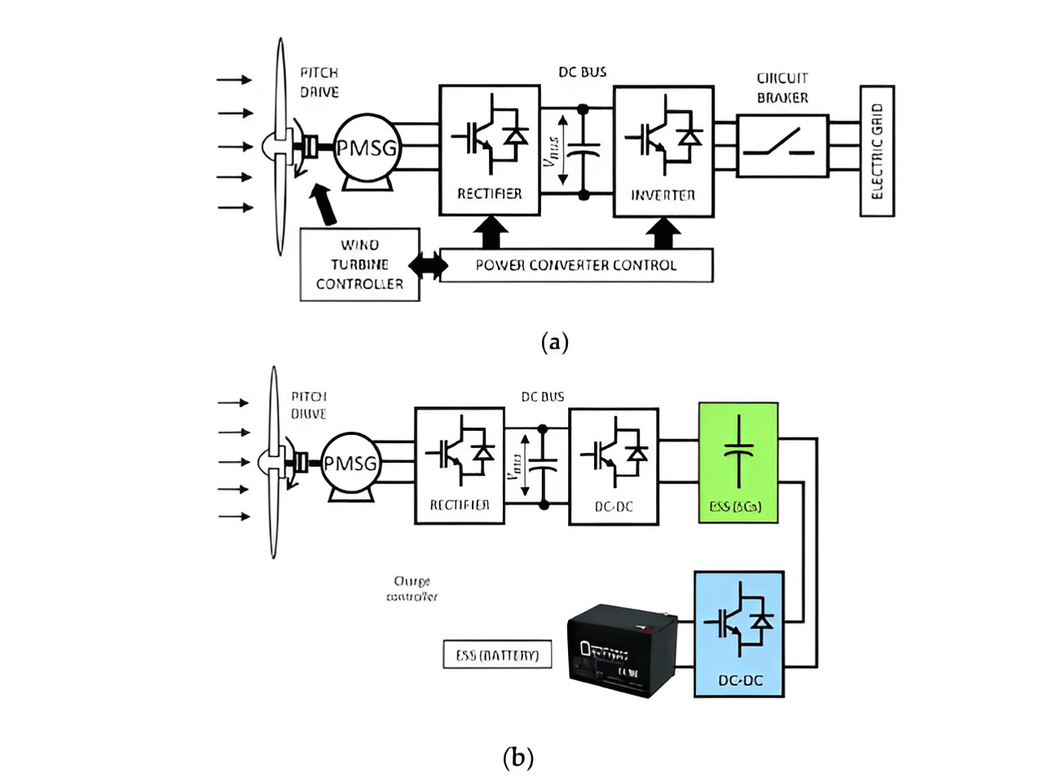
Circuit Diagram

Slide 7
Advantages:
01. Renewable and eco-friendly energy source.
02. Provides free charging for passengers.
03. Reduces dependency on conventional power sources.
04. Can be installed in public transport easily.
05. Works efficiently in high-speed vehicles.

Slide 8
Applications:
01
02
Long-distance travel to provide continuous charging
Public buses and trains for passenger convenience
03
04
Emergency power backup for mobile devices
Smart city infrastructure for sustainable transport

Slide 9
FUTURE SCOPE:
1. Integration with solar panels for additional energy generation.
2. Wireless charging options for improved convenience.
3. Smart monitoring system for energy tracking and efficiency improvement.
4. Scaling up for charging laptops and other electronic devices

Slide 10
Conclusion
This project presents a sustainable and innovative solution for mobile charging in moving vehicles. By harnessing wind energy through turbines, it provides a cost-effective and eco-friendly alternative to conventional charging methods

Slide 11
THANK YOU

